Slide 1
STEM-VIEW: A Graphical Interface for Physics Education
Philippe Laporte
Ph.D. Student in Medical Physics at the University of Montréal
University and College Instructor in physics and mathematics
Philippe.laporte.3@umontreal.ca

Slide 2
Overview
Background
Introductory Example: Beam Hardening in Medical Physics
What is it?
Caveats
Where to find it
How to use it
Another example: Three Body Problem
A handful of examples
Unité administrative (sur 1 ou 2 lignes)

Slide 3
Aim of the Presentation
Present STEM-View and illustrate its use in educational physics (and mathematics).

Slide 4
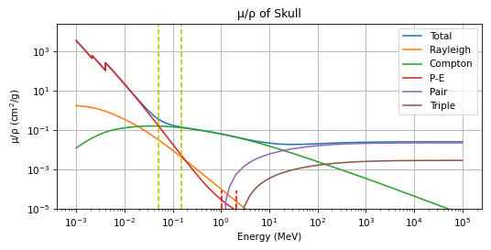
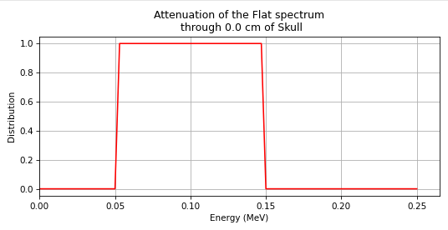
Beam Hardening: The essentials
The coefficient of linear attenuation describes the probability of a photon to interact with matter, with the Law of Beer-Lambert: $I\left(x\right)=I_{0}e^{−μx}$
This coefficient depends on the material (Z) and the energy of the photon (hv).
In diagnostic X-ray regions (hv between 50 keV and 150 keV), low energy photons disappear more rapidly than higher energy ones.
The average energy of the beam increases.
This phenomenon is called beam hardening.

Slide 5
Beam Hardening: Interactive Video I

Slide 6
Beam Hardening: Interactive Video II

Slide 7
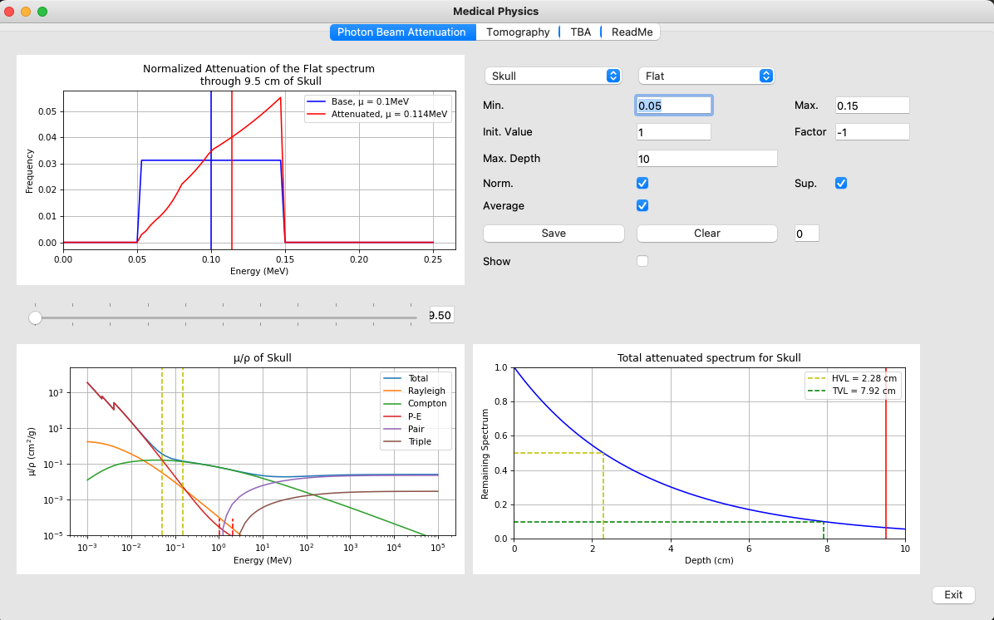
Beam Hardening: Global View

Slide 8
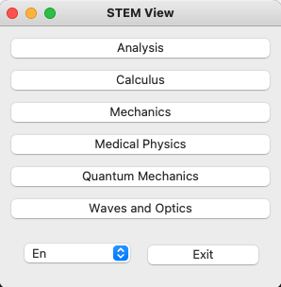
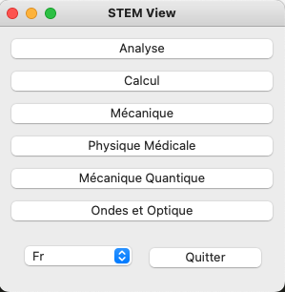
What is it? I
Bilingual (French and English) Graphical User Interface;
Entirely written in Python;
Source Code freely available (Github): GitHub;
Packaged Version freely available (DropBox): DropBox.

Slide 9
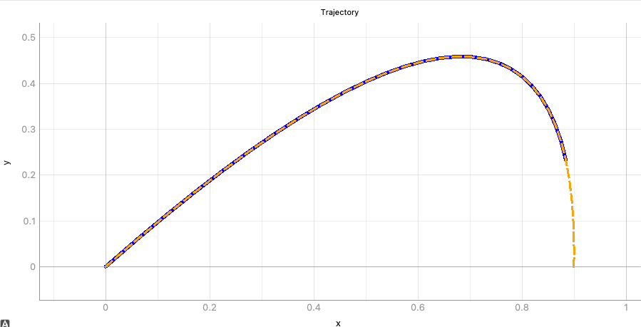
What is it? II
Shows concepts that can be difficult to grasp without a visual support.
Allows the user to play with settings and develop an intuition for the answer.
Presents topics in differential calculus, mechanics, analysis, medical physics, and more to come

Slide 10
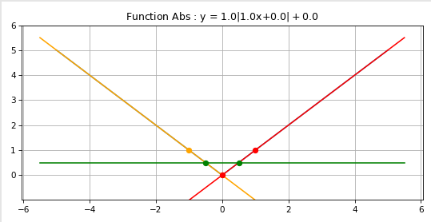
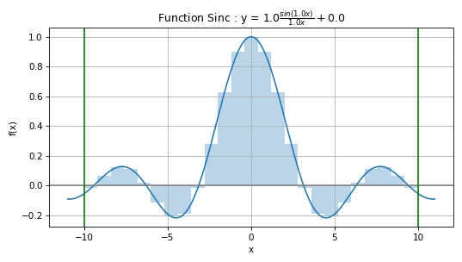
What is it? III
The source code can be modified and expanded;
New modules can be added;
Can be extended to other natural languages.

Slide 11
Caveats
One-person project;
Roller-coaster evolution (sporadic bursts);
Documentation not yet done.

Slide 12
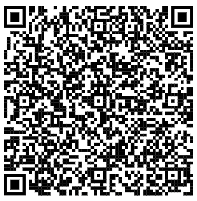
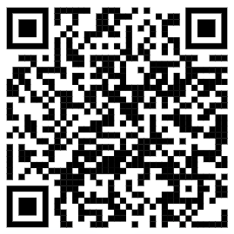
Where to find it
DropBox
GitHub

Slide 13
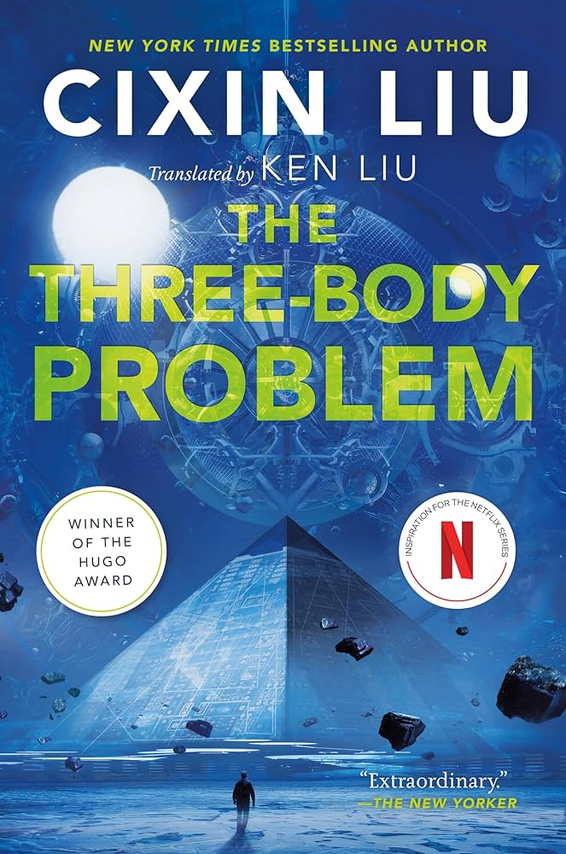
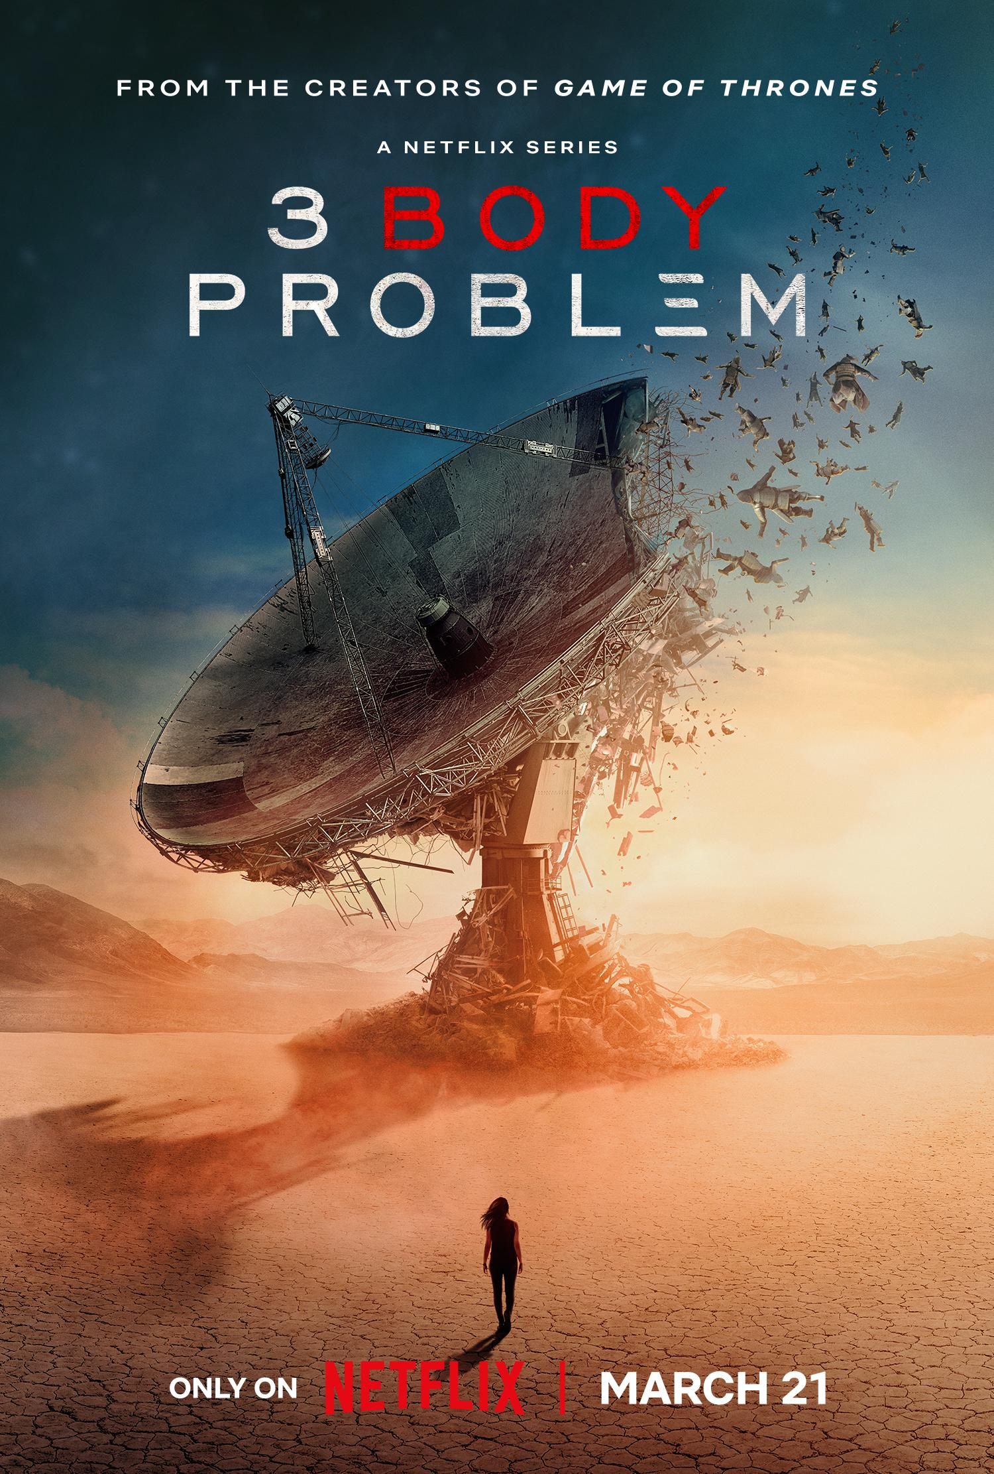
Another Example: Three Body Problem

Slide 14
Another Example: Three Body Problem

Slide 15
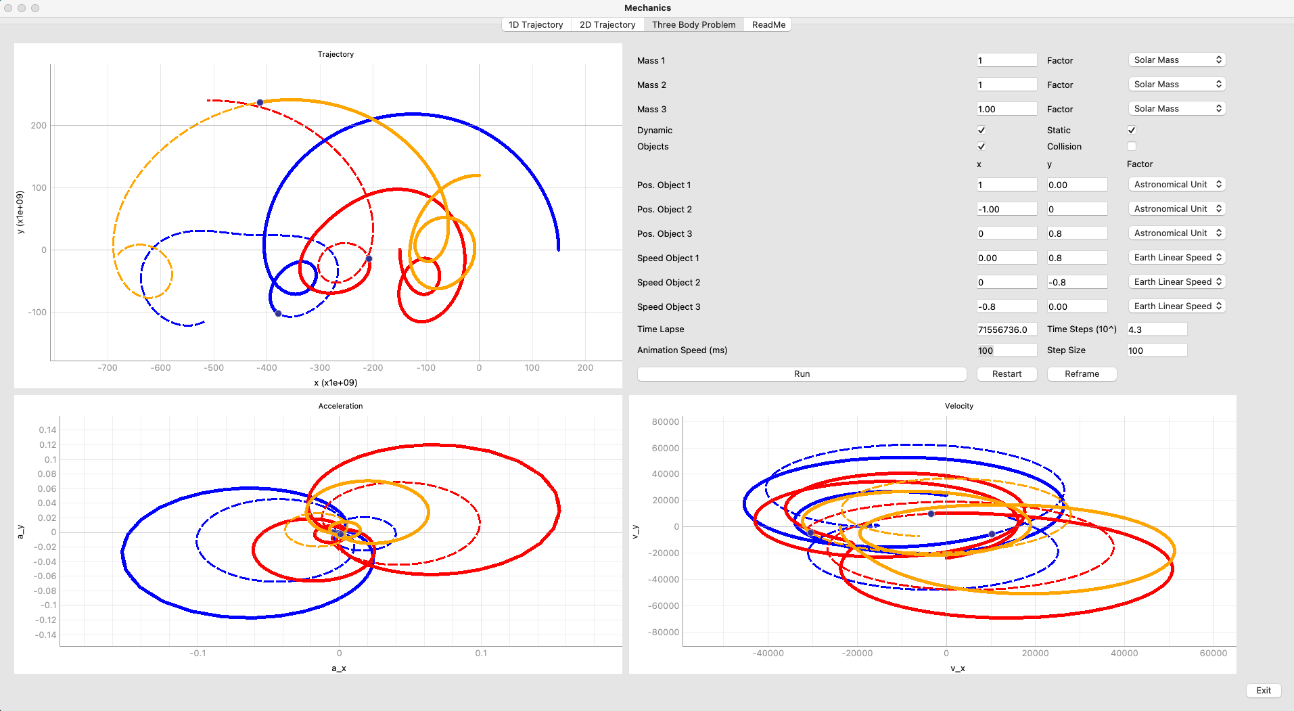
Another Example: Three Body Problem

Slide 16
Another Example: Three Body Problem
Same parameters, except a 20% variation in the initial speed of the yellow object

Slide 17
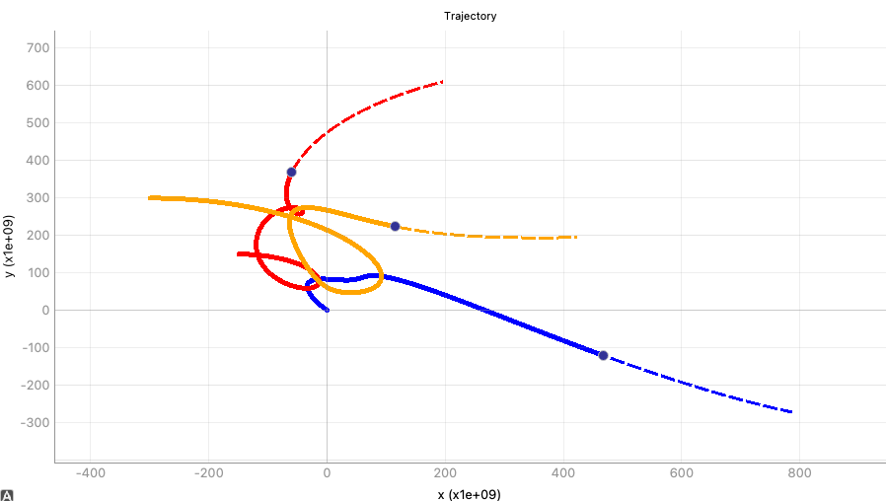
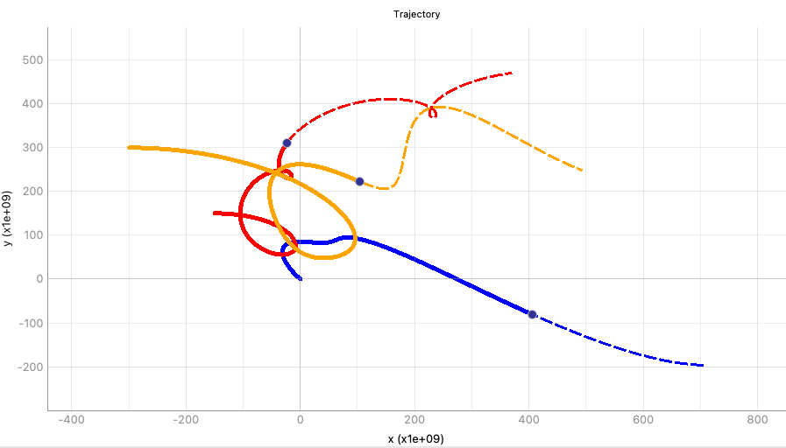
Another Example: Three Body Problem
Same parameters, except a 10% variation in the initial speed of the red object

Slide 18
Conclusion
Visual-STEM
GUI
Physics and Mathematics
STEM-View is a freely available (source code and package) useful for visualizing concepts in STEM;
It can help students with the understanding of new complex topics and it allows them to play with parameters to view their impacts;
It will keep on expanding in the future!

Slide 19
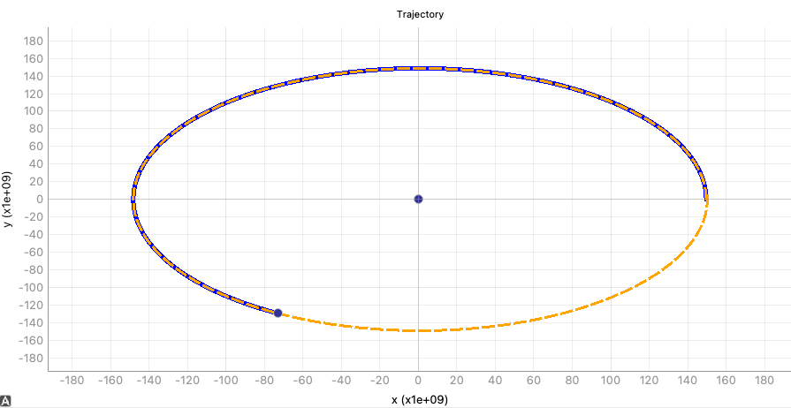
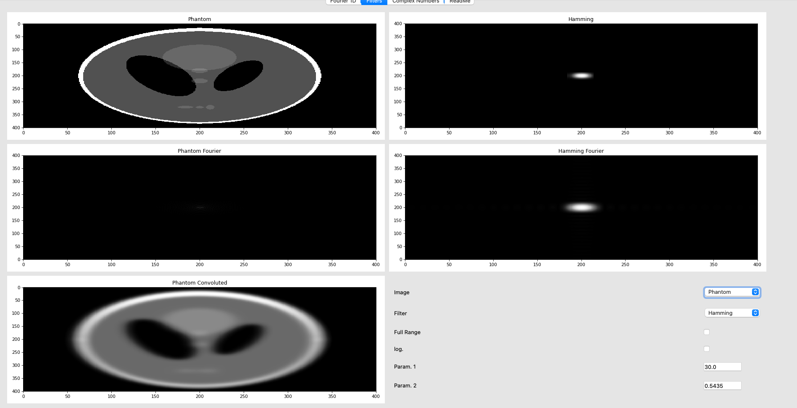
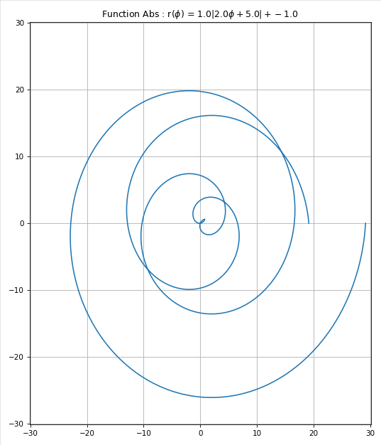
Other Stuff

Slide 20
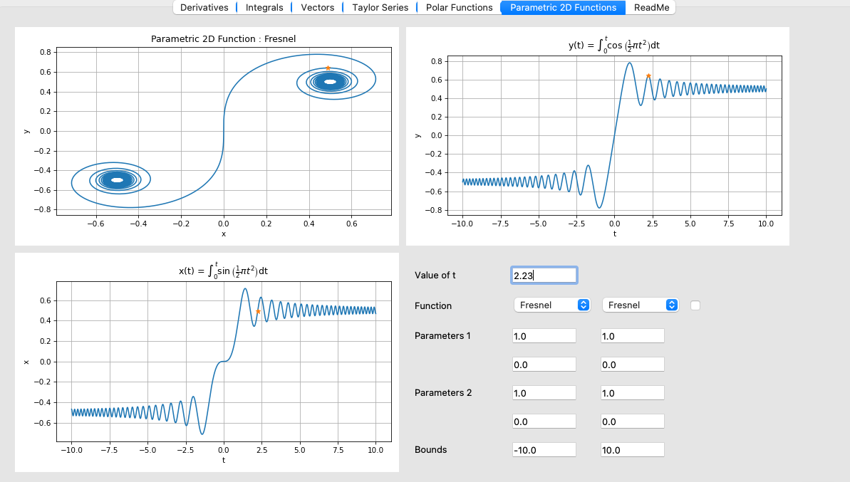
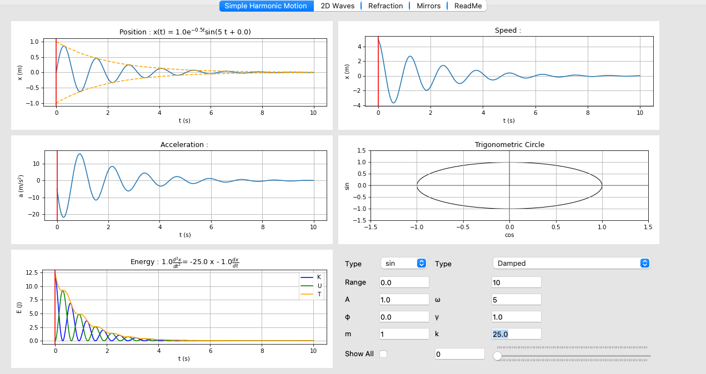
Other Stuff

Slide 21
Where to find it
DropBox
GitHub

